Slide 1
Java 8
Parameswari Ettiappan

Slide 2
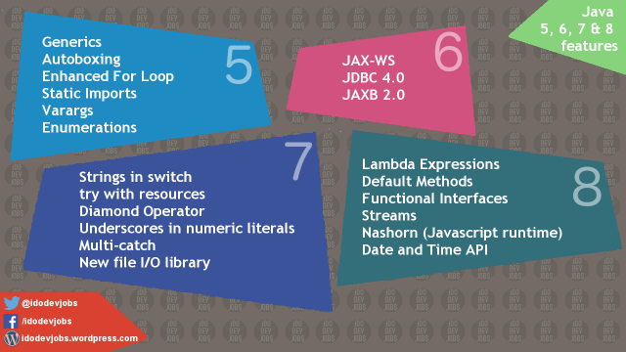

Slide 3
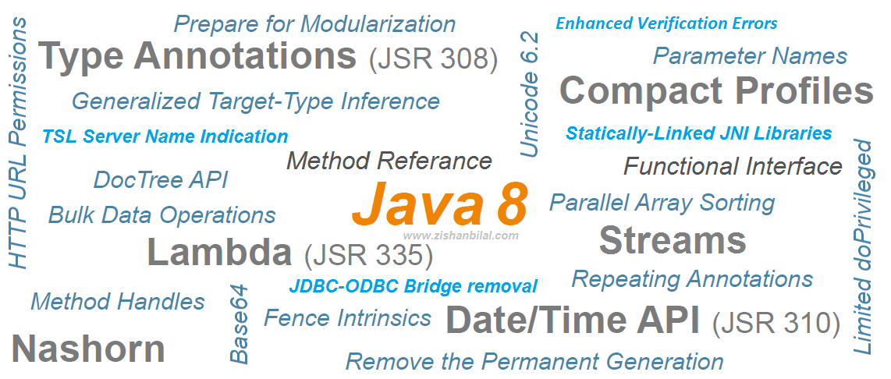

Slide 4
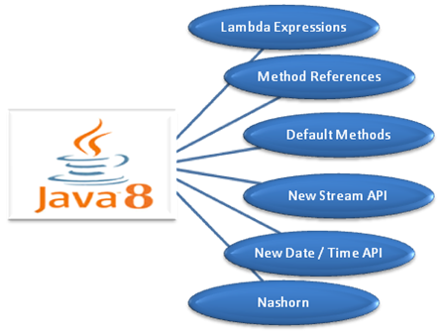

Slide 5
Java 8 Features
Java Programming Languages
Lambda Expressions, a new language feature
Method references provide easy-to-read lambda expressions for methods that already have a name.
Default methods enable new functionality to be added to the interfaces of libraries and ensure binary compatibility with code written for older versions of those interfaces.
Repeating Annotations provide the ability to apply the same annotation type more than once to the same declaration or type use.
Type Annotations provide the ability to apply an annotation anywhere a type is used, not just on a declaration. Used with a pluggable type system, this feature enables improved type checking of your code.
Improved type inference.
Method parameter reflection.

Slide 6
Java 8 Features
Collections
Classes in the new java.util.stream package provide a Stream API to support functional-style operations on streams of elements.
The Stream API is integrated into the Collections API, which enables bulk operations on collections, such as sequential or parallel map-reduce transformations.
Performance Improvement for HashMaps with Key Collisions

Slide 7
Java 8 Features
Concurrency
Classes and interfaces have been added to the java.util.concurrent package.
Methods have been added to the java.util.concurrent.ConcurrentHashMap class to support aggregate operations based on the newly added streams facility and lambda expressions.
Classes have been added to the java.util.concurrent.atomic package to support scalable updatable variables.

Slide 8
Java 8 Features
Concurrency
Methods have been added to the java.util.concurrent.ForkJoinPool class to support a common pool.
The java.util.concurrent.locks.StampedLock class has been added to provide a capability-based lock with three modes for controlling read/write access.

Slide 9
Java 8 Features
Networking
The class java.net.URLPermission has been added.
In the class java.net.HttpURLConnection, if a security manager is installed, calls that request to open a connection require permission.

Slide 10
Java 8 Features
JDBC
The JDBC-ODBC Bridge has been removed.
JDBC 4.2 introduces new features.
Java DB
JDK 8 includes Java DB 10.10.

Slide 11
Java 8 Features
HotSpot
Hardware intrinsics were added to use Advanced Encryption Standard (AES).
The UseAES and UseAESIntrinsics flags are available to enable the hardware-based AES intrinsics for Intel hardware.
The hardware must be 2010 or newer Westmere hardware. For example, to enable hardware AES, use the following flags:
-XX:+UseAES -XX:+UseAESIntrinsics

Slide 12
Java 8 Features
HotSpot
To disable hardware AES use the following flags:
-XX:-UseAES -XX:-UseAESIntrinsics
Removal of PermGen.
Default Methods in the Java Programming Language are supported by the byte code instructions for method invocation.

Slide 13
Java 8 Features
Compact Profiles contain predefined subsets of the Java SE platform and enable applications that do not require the entire Platform to be deployed and run on small devices.

Slide 14
Java 8 Features
Security
client-side TLS 1.2 enabled by default
New variant of AccessController.doPrivileged that enables code to assert a subset of its privileges, without preventing the full traversal of the stack to check for other permissions
Stronger algorithms for password-based encryption
SSL/TLS Server Name Indication (SNI) Extension support in JSSE Server

Slide 15
Java 8 Features
Security
Support for AEAD algorithms
KeyStore enhancements, including the new Domain KeyStore type java.security.DomainLoadStoreParameter, and the new command option -importpassword for the keytool utility
SHA-224 Message Digests
Enhanced Support for NSA Suite B Cryptography
Better Support for High Entropy Random Number Generation

Slide 16
Java 8 Features
Security
New java.security.cert.PKIXRevocationChecker class for configuring revocation checking of X.509 certificates
64-bit PKCS11 for Windows
New rcache Types in Kerberos 5 Replay Caching

Slide 17
Java 8 Features
Security
Support for Kerberos 5 Protocol Transition and Constrained Delegation
Kerberos 5 weak encryption types disabled by default
Unbound SASL for the GSS-API/Kerberos 5 mechanism
SASL service for multiple host names

Slide 18
Java 8 Features
Security
JNI bridge to native JGSS on Mac OS X
Support for stronger strength ephemeral DH keys in the SunJSSE provider
Support for server-side cipher suites preference customization in JSSE

Slide 19
Java 8 Features
JavaFX
The new SwingNode class enables developers to embed Swing content into JavaFX applications.
The new UI Controls include the DatePicker and the TreeTableView controls.
The javafx.print package provides the public classes for the JavaFX Printing API.

Slide 20
Java 8 Features
JavaFX
The 3D Graphics features now include 3D shapes, camera, lights, subscene, material, picking, and antialiasing.
The WebView class provides new features of HTML5 including Web Sockets, Web Workers, and Web Fonts.
Enhanced text support including bi-directional text and complex text scripts such as Thai and Hindi in controls, and multi-line, multi-style text in text nodes.
Support for Hi-DPI displays has been added in this release.

Slide 21
Java 8 Features
JavaFX
The CSS Styleable* classes became public API.
The new ScheduledService class allows to automatically restart the service.
JavaFX is now available for ARM platforms. JDK for ARM includes the base, graphics and controls components of JavaFX.

Slide 22
Java 8 Features
Tools
The jjs command is provided to invoke the Nashorn engine.
The java command launches JavaFX applications.
The java man page has been reworked.

Slide 23
Java 8 Features
Tools
The jdeps command-line tool is provided for analyzing class files.
Java Management Extensions (JMX) provide remote access to diagnostic commands.
The jarsigner tool has an option for requesting a signed time stamp from a Time Stamping Authority (TSA).

Slide 24
Java 8 Features
Javac tool
The javac tool now has support for checking the content of javadoc comments for issues that could lead to various problems, such as invalid HTML or accessibility issues, in the files that are generated when javadoc is run.
Javadoc tool
The javadoc tool supports the new DocTree API that enables you to traverse Javadoc comments as abstract syntax trees.
The javadoc tool supports the new Javadoc Access API that enables you to invoke the Javadoc tool directly from a Java application, without executing a new process.

Slide 25
Java 8 Features
Internationalization
Unicode Enhancements, including support for Unicode 6.2.0
Adoption of Unicode CLDR Data and the java.locale.providers System Property
New Calendar and Locale APIs
Ability to Install a Custom Resource Bundle as an Extension

Slide 26
Java 8 Features
Deployment
For sandbox applets and Java Web Start applications, URLPermission is now used to allow connections back to the server from which they were started. SocketPermission is no longer granted.
The Permissions attribute is required in the JAR file manifest of the main JAR file at all security levels.

Slide 27
Java 8 Features
Date-Time Package - a new set of packages that provide a comprehensive date-time model.
Scripting
Nashorn Javascript Engine
Pack200
Pack200 Support for Constant Pool Entries and New Bytecodes Introduced by JSR 292
JDK8 support for class files changes specified by JSR-292, JSR-308 and JSR-335

Slide 28
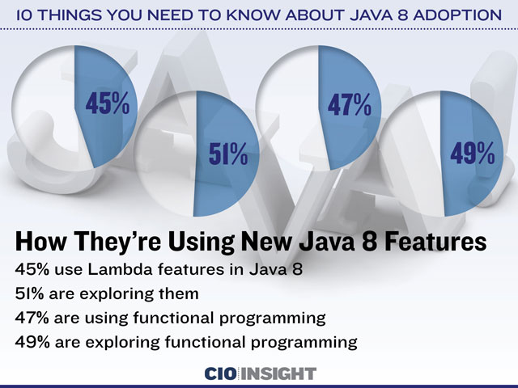

Slide 29
Annotations
Annotations are tags inserted into the source code that some tools can process.
In Java SE, annotations are used for simple purposes, such as marking deprecated
features or suppressing warnings.
Annotations have a much more important role in Java EE where they are used to configure just about any aspect of an application, replacing painful boilerplate code and XML customization that was the bane of older Java EE versions.
Java 8 has two enhancements to annotation processing: repeated annotations and type use annotations.

Slide 30
Annotations
Before Java 8, we can use annotations at many places but only on declarations e.g. on classes, interfaces, fields, method declaration etc.
In Java 8 we can generally use annotations on any use of a type, , e.g. with generics, with method return types, with object initiation using 'new', with 'implements' and 'extends' clauses, with type casts and with throws clauses. etc.

Slide 31
New Target Element Type in Java 8
The enum constants provided by jva.lang.annotation.ElementType are used in java.lang.annotation.Target meta-annotations to specify where it is legal to write annotations of a given type.
Java 8 introduced two new Element types
ElementType.TYPE_USE: allows an annotation to be applied at any type use.
ElementType.TYPE_PARAMETER: allows an annotation to be applied at type variables (e.g. T in MyClass<T>).
@Target({ElementType.TYPE_USE, ElementType.TYPE_PARAMETER})
public @interface MyAnnotation {
}

Slide 32
Usage Examples
extends clause:
public class MyClass extends @MyAnnotation OtherClass { }
implements clause:
public class MyClass implements @MyAnnotation someInterface { }
Generics
public class MyClass<@MyAnnotation T> {}

Slide 33
Usage Examples
List<@MyAnnotation String> myList;
List<@MyAnnotation T> myList;
List<@MyAnnotation ? extends OtherClass> myList;
List<@MyAnnotation ? super T> myList
List<@MyAnnotation ?> myList;
Simple Field Types
private @MyAnnotation String str;
private @MyAnnotation List<String> mylist

Slide 34
Usage Examples
On arrays
private @MyAnnotation char[] chars; //on char
private @MyAnnotation char[][] chars2;//on char
private char @MyAnnotation [] chars3;//on char array, char[]
private char[] @MyAnnotation [] chars4; //on char array, char[] which is component of char[][]

Slide 35
Usage Examples
Nested type
MyClass.@MyAnnotation NestedClass nestedClass;//NestedClass is nested class of MyClass
Creating objects
List<String> list = new @MyAnnotation ArrayList<>();
MyClass myClass = new @MyAnnotation MyClass();
Creating non-static nested class object
MyClass myClass = new @MyAnnotation MyClass();
MyClass.NestedClass nestedClass = myClass.new @MyAnnotation NestedClass();

Slide 36
Usage Examples
Type casting
MyClass myClass = (@MyAnnotation MyClass) otherClassInstance;
instanceof
boolean b = myObject instanceof @MyAnnotation OtherClass;
Method return type
public @MyAnnotation String getString(){.....}
Method parameters
public void showString(@MyAnnotation String str){.....}
Calling generic method
myObject.<@MyAnnotation String>myMethod(.....)

Slide 37
Usage Examples
Local variables
public void myMethod(){
@MyAnnotation List<String> str = new ArrayList<>();
}
Java 8 method references
Function<MyClass, String> f = @MyAnnotation MyClass::myMethod;
throws clause
void myMethod() throws @MyAnnotation Exception{}
catch clause
try {
myObject.myMethod();
} catch (@MyAnnotation Exception e) {
.....
}

Slide 38
Annotations On Java Types
Annotations can currently only be used on type declarations
Classes, methods, variable definitions
Extension for places where types are used
e.g. parameters
Permits error detection by pluggable type checkers
e.g. null pointer errors, race conditions, etc
public void process(@notnull List data) {…}
Notes:
Moving on from Lambdas and the streams APIs there are a number of other changes to the language and llibraries in Java SE 8.
Another significant language change is the ability to use annotations on the use of types now, rathe than just where they are declared. This means that annotations can be added to parameters being passed to a method. Using new annotations like @notnull the compiler can make more checks on the correctness of code as it is compiled. Here, if the value passed as a parameter to the process method is never assigned a value the compiler can report an error. Obviously only static analysis can be done of the code as it is compiled, it will still be possible to pass a null reference at runtime.
See also JEP 104

Slide 39
Lambda Expressions
A lambda expression is an unnamed block of code (or an unnamed function) with a list of formal parameters and a body.
Sometimes a lambda expression is simply called a lambda.
The body of a lambda expression can be a block statement or an expression.
An arrow (->) is used to separate the list of parameters and the body.
The term “lambda” in "lambda expression" has its origin in Lambda calculus that uses the Greek letter lambda (l) to denote a function abstraction.

Slide 40
Lambda Expressions
Some Details
Lambda expressions represent anonymous functions
Like a method, has a typed argument list, a return type, a set of thrown exceptions, and a body
Not associated with a class
We now have parameterized behaviour, not just values
double highestScore = students.stream().
filter(Student s -> s.getGradYear() == 2011)
mapToDouble(Student s -> s.getScore())
max();
What
How
Notes:
We define a Lambda expression as an anonymous function (like a method, but because it is not associated with a class we call it a function). Like methods there are parameters, a body, a return type and even thrown exceptions.
What Lambda expressions really brings to Java is a simple way to parameterise behaviour. The sequence of methods we have here defines what we want to do, i.e. filter the stream, map its values and so on, but how this happens is defined by the Lamabda expressions we pass as parameters.

Slide 41
Lambda Expressions
Functional Interfaces
Definition
A functional interface is an interface with only one abstract method
However, the interface may have more than one method
Identified structurally
Type is inferred from the context
Works for both assignment and method parameter contexts
The type of a Lambda expression is a functional interface
Instances of functional interfaces are created with Lambda expressions
@FunctionalInterface annotation
Notes:
A Lambda expression can be used wherever a functional interface can be used. A functional interface is an interface that has only one abstract method, these are often referred to as single abstract method (SAM) types. This can be a bit confusing though, as functional interfaces can have more than one method, so long as only one of them is abstract, for instance the Predicate interface in the new java.util.function package is a functional interface, but has five methods. How can this be? Java SE 8 introduces two other new features, default methods (which we’ll cover in a moment) and static methods in interfaces. Neither of these are abstract, so Predicate has one abstract method, three default methods and on static method, which means it still conforms to the requirements. A Lambda expressions is a way of creating instances of functional interfaces.
There is a new annotation, @FunctionalInterface. If an interface is marked with this the compiler will verify that it conforms to the structure of a functional interface, i.e. it has only one abstract method. If the interface does not have only a single abstract method the compiler will report an error.

Slide 42
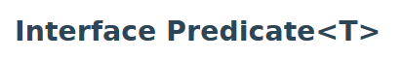
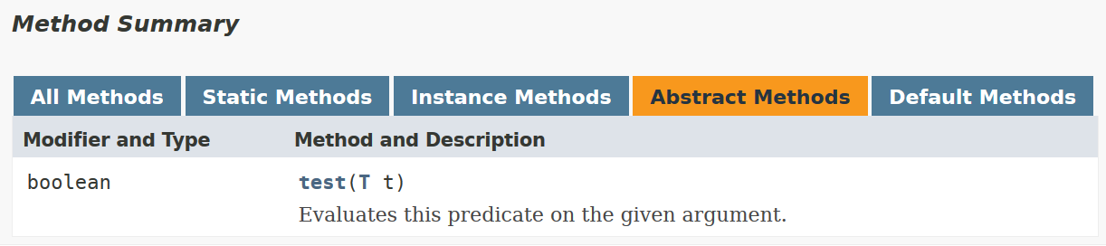
Internal Iteration With Lambdas
filter(Student s -> s.getGradYear() == 2011)
The type of this lambda is the Predicate functional interface
The lambda expression is an implementation of the test() method.
Notes:
Java SE 8 introduces Lambda expressions, which you can think of as being like a method, but without being associated with a specific class (they are anonymous). The parameters of the Lambda expression are on the left side of the arrow and the body of the lambda expression is on the right of the arrow. There does not need to be an explicit return statement (although there can be); in these examples the compiler will infer the return type from the structure of the Lambda expression and where it is used, so the type of the interface is known. This is much more readable and therefore easier to write and maintain.

Slide 43
Type Inferrence
The compiler can often infer parameter types in a Lambda expression
Inferrence uses the target functional interface’s method signature
Fully statically typed (no dynamic typing sneaking in)
More typing with less typing
static T void sort(List<T> l, Comparator<? super T> c);
List<String> ls = getList();
Collections.sort(ls, (String x, String y) -> x.length() - y.length());
Collections.sort(ls, (x, y) -> x.length() - y.length());
Notes:
Using generics that were introduced in Java SE 5 the compiler can determine type information for things like collections. Here we have a method, sort, that takes a list and a functional interface, Comparator as parameters. The type parameters for the List and the Comparator are related, so the compiler can infer the type of parameters for the Lambda expression based on this. In this example we create a List of type String and then define the Lambda expression to compare two Strings by length. Since the compiler knows the List is of type String we do not need to explictly state that x and y are Strings; the compiler will infer this for us. Don’t be confused by this, this is not allowing any form of dynamic typing into Java, it is simply more typing (of objects) with less typing (on the keyboard).

Slide 44
Lambda Expressions
Local Variable Capture & Lexical Scoping
Lambda expressions can refer to effectively final local variables from the enclosing scope
This means a variable behaves as if it is marked final (even if it is not)
The variable is assigned once
Lambda expressions are anonymous functions
They are not associated with an object
this will refer to the object in the surrounding scope
Notes:
There are some differences to be aware of between anonymous inner classes (AIC) and Lambda expressions. With an AIC any variable you refer to in the scope of the surrounding code must be final. With a Lambda expression this has been relaxed so variables referenced can be effectively final. This means they must behave the same way as if they were marked final, i.e. the value can be set once and once only.
Since Lambda expressions reprsent an anonymous function they have no class associated with them. Therefore, unlike AICs when you refer to ‘this’ in a Lambda expression it refers to the ‘this’ of the surrounding scope.

Slide 45
Method References
If a lambda only calls a method …
void createUI() {
Button button = new Button("Guess What I'm Thinking");
button.setOnAction(e -> guess(e)); // lambda only calls a method
...
}
void guess(ActionEvent event) {
Button button = (Button) event.getSource();
button.setText("You love Lambda!");
}
Copyright © 2012, Oracle and/or its affiliates. All rights reserved.

Slide 46
Method References
If a lambda only calls a method,
… you can use a method reference
void createUI() {
Button button = new Button("Guess What I'm Thinking");
button.setOnAction(this::guess); // use method reference
...
}
void guess(ActionEvent event) {
Button button = (Button) event.getSource();
button.setText("You love Lambda!");
}
Copyright © 2012, Oracle and/or its affiliates. All rights reserved.

Slide 47
Method References
Method references let us reuse a method as a lambda expression
FileFilter x = (File f) -> f.canRead();
FileFilter x = File::canRead;
Notes:
Method references are a shorthand notation to use when the Lambda expression is simply a call to a method on a class.

Slide 48
Constructor References
Same concept as a method reference
For the constructor
Factory<List<String>> f = () -> return new ArrayList<String>();
Equivalent to
Factory<List<String>> f = ArrayList<String>::new;
Notes:
In the same way that method references can be used as a shorthand notation a constructor reference can be used as a shorthand way of calling the constructor of a specific class. Note here that a Lambda expression that has no arguments must use empty brackets to indicate this fact.

Slide 49
Four Kinds of Method References
1) Reference to a static method:
ContainingClass::staticMethodName
2) Reference to an instance method of a particular object:
ContainingObject::instanceMethodName
3) Reference to an instance method of an arbitrary object of a particular type:
ContainingType::methodName
4) Reference to a constructor:
ClassName::new
Copyright © 2012, Oracle and/or its affiliates. All rights reserved.

Slide 50
Default Methods
Provide a mechanism to add new methods to existing interfaces
Without breaking backwards compatability
Gives Java multiple inheritance of behaviour, as well as types
but not state!
public interface Set<T> extends Collection<T> {
... // The existing Set methods
default Spliterator<E> spliterator() {
return Spliterators.spliterator(this, Spliterator.DISTINCT);
}
}
Notes:
To add more power to the collections API which is used extensively in Java applications there needs to be a way to add methods to existing interfaces (which are used frequently in the Collections API). The problem is that adding a new method to an interface will break backwards compatability if you try to call that method on an older version (since it will not be possible to resolve the method, causing an error). In Java SE 8 there are now extension, or default methods. When adding a new method to an interface a default implementation can also be specified. When an old version of the interface is used and the new method is called it will be resolved to the default version. In the example calling reduce where there is no implementation will result in a call to Collections.setReducer.
Some people look at this as adding multiple inheritance to Java, which is true, but Java already has multiple inheritance of type by using interfaces. We are now adding multiple inheritance of behaviour, but not state (as is used in true multiple inheritance languages like C++).
You do need to be aware of an issue with this. If you declare a class that implements two interfaces, both of which have a method with the same signature and default implementation and the class does not implement that method the compiler will not know which version to use. In this case you will get a compiler error and will need to resolve this problem by hand.

Slide 51
Static Methods In Interfaces
Previously it was not possible to include static methods in an interface
Static methods, by definition, are not abstract
@FunctionalInterface can have zero or more static methods
static <T> Predicate<T> isEqual(Object target) {
return (null == target)
? Objects::isNull
: object -> target.equals(object);
}
Notes:
Another new feature of interfaces in Java SE 8 is the ability to include static methods in an interface, which was not possible before. This is linked to extension methods in that interfaces can now include behaviour. The example shows a static method defined in the Predicate interface in the java.util.function package.

Slide 52
Lambda Expressions

Slide 53
Lambda Expressions

Slide 54
Lambda Expressions
// Takes an int parameter and returns the parameter value incremented by 1
(int x) -> x + 1
// Takes two int parameters and returns their sum
(int x, int y) -> x + y
// Takes two int parameters and returns the maximum of the two
(int x, int y) -> { int max = x > y ? x : y;
return max;
}
// Takes no parameters and returns void
() -> { }

Slide 55
Lambda Expressions
// Takes no parameters and returns a string "OK"
() -> "OK"
// Takes a String parameter and prints it on the standard output
(String msg) -> { System.out.println(msg); }
// Takes a parameter and prints it on the standard output
msg -> System.out.println(msg)
// Takes a String parameter and returns its length
(String str) -> str.length()

Slide 56
Why Do We Need Lambda Expressions
A lambda expression is a block of code that can be passed around to execute.
It is a common feature for some programming languages, such as Lisp, Python, Scala, etc.
But before Java 8, we can not do the same in Java.
If we want a block of code to be executed, we need to create an object and pass the object around, such as using the strategy design pattern.
From Java 8, lambda expressions enable us to treat functionality as method argument and pass a block of code around.

Slide 57
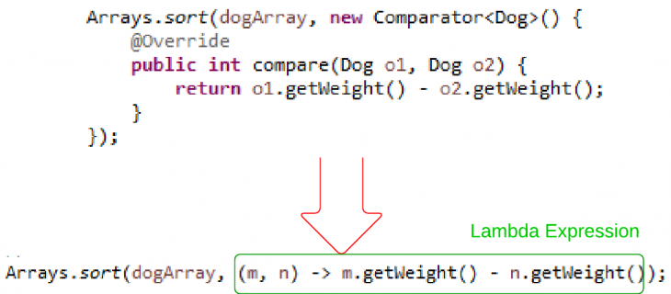
Why Do We Need Lambda Expressions

Slide 58
Syntax for Lambda Expressions
(<LambdaParametersList>) -> { <LambdaBody> }
A lambda expression consists of a list of parameters and a body that are separated by an arrow (->).
The list of parameters is declared the same way as the list of parameters for methods.
The list of parameters is enclosed in parentheses, as is done for methods.
The body of a lambda expression is a block of code enclosed in braces.
Like a method's body, the body of a lambda expression may declare local variables;
use statements including break, continue, and return; throw exceptions, etc.

Slide 59
Syntax for Lambda Expressions
Unlike a method, a lambda expression does not have four parts.
A lambda expression does not have a name.
• A lambda expression does not have a return type.
It is inferred by the compiler from the context of its use and from its body.
• A lambda expression does not have a throws clause. It is inferred from the context of its use and its body.
• A lambda expression cannot declare type parameters. That is, a lambda expression
cannot be generic.

Slide 60
Omitting Parameter Types
You can omit the declared type of the parameters.
The compiler will infer the types of parameters from the context in which the lambda expression is used.
// Types of parameters are declared
(int x, int y) -> { return x + y; }
// Types of parameters are omitted
(x, y) -> { return x + y; }

Slide 61
Omitting Parameter Types
// A compile-time error
(int x, y) -> { return x + y; }

Slide 62
Declaring a Single Parameter
// Declares the parameter type
(String msg) -> { System.out.println(msg); }
// Omits the parameter type
(msg) -> { System.out.println(msg); }
// Omits the parameter type and parentheses
msg -> { System.out.println(msg); }

Slide 63
Declaring a Single Parameter
The following lambda expression will not compile:
// Omits parentheses, but not the parameter type, which is not allowed.
String msg -> { System.out.println(msg); }

Slide 64
Declaring No Parameters
If a lambda expression does not take any parameters, you need to use empty parentheses.
// Takes no parameters
() -> { System.out.println("Hello"); }
It is not allowed to omit the parentheses when the lambda expression takes no parameter.
The following declaration will not compile:
-> { System.out.println("Hello"); }

Slide 65
Parameters with Modifiers
You can use modifiers, such as final, in the parameter declaration for explicit lambda expressions. The following two
lambda expressions are valid:
(final int x, final int y) -> { return x + y; }
(int x, final int y) -> { return x + y; }
The following lambda expression will not compile because it uses the final modifier in parameter declarations, but omits the parameter type:
(final x, final y) -> { return x + y; }

Slide 66
Declaring Body of Lambda Expressions
The body of a lambda expression can be a block statement or a single expression.
A block statement is enclosed in braces; a single expression is not enclosed in braces.
When a block statement is executed the same way as a method’s body.
A return statement or the end of the body returns the control to the caller of the lambda expression.
When an expression is used as the body, it is evaluated and returned to the caller.
If the expression evaluates to void, nothing is returned to the caller.
The following two lambda expressions are the same; one uses a block statement
and the other an expression:

Slide 67
Declaring Body of Lambda Expressions
// Uses a block statement. Takes two int parameters and returns their sum.
(int x, int y) -> { return x + y; }
// Uses an expression. Takes a two int parameters and returns their sum.
(int x, int y) -> x + y

Slide 68
Declaring Body of Lambda Expressions
The following two lambda expressions are the same; one uses a block statement as the body and the other an expression that evaluates to void:
// Uses a block statement
(String msg) -> { System.out.println(msg); }
// Uses an expression
(String msg) -> System.out.println(msg)

Slide 69
List of Functional Interfaces

Slide 70
Interface Summary
Interface | Description
BiConsumer<T,U> | Represents an operation that accepts two input arguments and returns no result.
BiFunction<T,U,R> | Represents a function that accepts two arguments and produces a result.
BinaryOperator<T> | Represents an operation upon two operands of the same type, producing a result of the same type as the operands.
BiPredicate<T,U> | Represents a predicate (boolean-valued function) of two arguments.
BooleanSupplier | Represents a supplier of boolean-valued results.
Consumer<T> | Represents an operation that accepts a single input argument and returns no result.
DoubleBinaryOperator | Represents an operation upon two double-valued operands and producing a double-valued result.
DoubleConsumer | Represents an operation that accepts a single double-valued argument and returns no result.
DoubleFunction<R> | Represents a function that accepts a double-valued argument and produces a result.
DoublePredicate | Represents a predicate (boolean-valued function) of one double-valued argument.
DoubleSupplier | Represents a supplier of double-valued results.
DoubleToIntFunction | Represents a function that accepts a double-valued argument and produces an int-valued result.
DoubleToLongFunction | Represents a function that accepts a double-valued argument and produces a long-valued result.
DoubleUnaryOperator | Represents an operation on a single double-valued operand that produces a double-valued result.

Slide 71
Function<T,R> | Represents a function that accepts one argument and produces a result.
IntBinaryOperator | Represents an operation upon two int-valued operands and producing an int-valued result.
IntConsumer | Represents an operation that accepts a single int-valued argument and returns no result.
IntFunction<R> | Represents a function that accepts an int-valued argument and produces a result.
IntPredicate | Represents a predicate (boolean-valued function) of one int-valued argument.
IntSupplier | Represents a supplier of int-valued results.
IntToDoubleFunction | Represents a function that accepts an int-valued argument and produces a double-valued result.
IntToLongFunction | Represents a function that accepts an int-valued argument and produces a long-valued result.
IntUnaryOperator | Represents an operation on a single int-valued operand that produces an int-valued result.
LongBinaryOperator | Represents an operation upon two long-valued operands and producing a long-valued result.
LongConsumer | Represents an operation that accepts a single long-valued argument and returns no result.
LongFunction<R> | Represents a function that accepts a long-valued argument and produces a result.
LongPredicate | Represents a predicate (boolean-valued function) of one long-valued argument.
LongSupplier | Represents a supplier of long-valued results.

Slide 72
LongToDoubleFunction | Represents a function that accepts a long-valued argument and produces a double-valued result.
LongToIntFunction | Represents a function that accepts a long-valued argument and produces an int-valued result.
LongUnaryOperator | Represents an operation on a single long-valued operand that produces a long-valued result.
ObjDoubleConsumer<T> | Represents an operation that accepts an object-valued and a double-valued argument, and returns no result.
ObjIntConsumer<T> | Represents an operation that accepts an object-valued and a int-valued argument, and returns no result.
ObjLongConsumer<T> | Represents an operation that accepts an object-valued and a long-valued argument, and returns no result.
Predicate<T> | Represents a predicate (boolean-valued function) of one argument.
Supplier<T> | Represents a supplier of results.
ToDoubleBiFunction<T,U> | Represents a function that accepts two arguments and produces a double-valued result.
ToDoubleFunction<T> | Represents a function that produces a double-valued result.
ToIntBiFunction<T,U> | Represents a function that accepts two arguments and produces an int-valued result.
ToIntFunction<T> | Represents a function that produces an int-valued result.
ToLongBiFunction<T,U> | Represents a function that accepts two arguments and produces a long-valued result.
ToLongFunction<T> | Represents a function that produces a long-valued result.
UnaryOperator<T> | Represents an operation on a single operand that produces a result of the same type as its operand.

Slide 73
Iterating with for each

Slide 74
iterating w/lambdas, type inference
List<Integer> numbers =
Arrays.asList(1, 2, 3, 4, 5, 6, 7, 8, 9, 10);
numbers.forEach(value -> System.out.println(value));

Slide 75
method references
List<Integer> numbers =
Arrays.asList(1, 2, 3, 4, 5, 6, 7, 8, 9, 10);
numbers.forEach(System.out::println);

Slide 76
transforms using map
List<Integer> numbers =
Arrays.asList(1, 2, 3, 4, 5, 6, 7, 8, 9, 10);
numbers.stream()
.map(value -> value * 2)
.forEach(System.out::println);

Slide 77
filtering
List<Integer> numbers =
Arrays.asList(1, 2, 3, 4, 5, 6, 7, 8, 9, 10);
numbers.stream()
.filter(value -> value % 2 == 0)
.forEach(System.out::println);

Slide 78
filtering v2
List<String> names = Arrays.asList(
"Bob", "Tom", "Jeff", "Scott", "Jennifer", "Steve");
final Function<String, Predicate<String>> startsWithLetter =
letter -> name -> name.startsWith(letter);
names.stream()
.filter(startsWithLetter.apply("J"))
.forEach(System.out::println);

Slide 79
Streams API
Aggregate Operations
Most business logic is about aggregate operations
“Most profitable product by region”
“Group transactions by currency”
As we have seen, up to now, Java mostly uses external iteration
Inherently serial
Frustratingly imperative
Java SE 8’s answer: Streams
With help from Lambdas
Notes:
Lambdas are great, because they give us a simple way to represent behaviour as a parameter, which we can pass to a method. On their own, though, they don’t give us much more than a simpler syntax for anonymous inner classes. To really extract the power of Lambdas and to provide simplified concurrency we need to use Lambdas and extension methods to enhance the Collections APIs as well as adding new classes.
The answer to this in Java SE 8 is the streams API, which, with help from Lambdas, brings a more functional style of programming to Java.

Slide 80
Stream Overview
High Level
Abstraction for specifying aggregate computations
Not a data structure
Can be infinite
Simplifies the description of aggregate computations
Exposes opportunities for optimization
Fusing, laziness and parallelism
Notes:
The first important point to understand about streams is that they are not data structures (even though they may look like them at times).
The second point is that a stream can be infinite (a stream of random numbers does not need to end). In the same way that it is very easy to write an infinite loop in Java, it’s possible to use an infinite stream and never terminate its use.
By using streams we can build a system that allows optimisations to be hidden easily in the library code (lazy evaluation, fusing operations together, making processing concurrent, etc)

Slide 81
Stream Overview
Pipeline
A stream pipeline consists of three types of things
A source
Zero or more intermediate operations
A terminal operation
Producing a result or a side-effect
Source
int sum = transactions.stream().
filter(t -> t.getBuyer().getCity().equals(“London”)).
mapToInt(Transaction::getPrice).
sum();
Intermediate operation
Terminal operation
Notes:
Think of a stream as a pipeline with three parts:
The source that provides a stream of objects to be processed.
Zero or more intermediate operations that take the input stream and generate a new output stream. The output stream may be the same as the input stream, reduced or enlarged in size, or be objects of a different type. It is completely flexible.
A terminal operation. This is one that takes an input stream and either produces a result or has some kind of side-effect. Printing a message to the screen is an example where no result is produced, but there is a side effect.
The example shows the different parts of the pipeline.

Slide 82
Stream Overview
Execution
The filter and map methods don’t really do any work
They set up a pipeline of operations and return a new Stream
All work happens when we get to the sum() operation
filter()/map()/sum() fused into one pass on the data
For both sequential and parallel pipelines
int sum = transactions.stream().
filter(t -> t.getBuyer().getCity().equals(“London”)). // Lazy
mapToInt(Transaction::getPrice). // Lazy
sum(); // Execute the pipeline
Notes:
Remember that a stream is not a data structure, but a way to construct a pipeline of operations. So things like filter and map don’t really do much except apply the Lambda expression to the input stream and generate a new output stream. In this example all the work really happens when we get to the sum method. The effect is that the three operations, filter, map and sum are fused into a single pipeline operation. This can happen either for a sequential or parallel stream.

Slide 83
Stream Sources
Many Ways To Create
From collections and arrays
Collection.stream()
Collection.parallelStream()
Arrays.stream(T array) or Stream.of()
Static factories
IntStream.range()
Files.walk()
Roll your own
java.util.Spliterator()
Notes:
The Collection class provides methods to create a serial or parallel stream.
Stream is an interface, but in Java SE 8 we can now have static methods in interfaces, hence Stream.of()
Files.walk will walk a file tree from a given Path argument
Spliterator is an interface that represents an object for traversing or partitioning elements of a source (this is the fundamental internal class for streams).

Slide 84
Stream Sources
Manage Three Aspects
Access to stream elements
Decomposition (for parallel operations)
Fork-join framework
Stream characteristics (See Spliterator javadoc)
ORDERED
DISTINCT
SORTED
SIZED
SUBSIZED
NONNULL
IMMUTABLE
CONCURRENT
Notes:
Stream sources allow for the decomposition of a stram so that it can be processed in parallel. How this happens internally is using the fork-join framework.
Streams have characteristics that can be used internally to determine how to make optimisations when processing the stream
ORDERED The stream has a defined order (this does not imply that it is sorted, just that the order is fixed). For example a List has a fixed order to the elements of that list. A HashMap does not have a defined order.
DISTINCT No two elements in the stream are equal
SORTED The stream has an order that has been sorted according to some criteria, e.g. alphabetical, numeric. Any stream that is sorted is also ORDERED
SIZED The stream is finite, i.e. has a known size
SUBSIZED If this stream is split for the purposes of parallel processing the size of the child streams will be known. A balanced tree is an example where this is not true. The size of the tree itself is known, but the size of subtrees may not be.
NONNULL There will be no null elements in the stream
IMMUTABLE The stream cannot be structurally modified (no elements can be inserted, replaced or deleted)
CONCURRENT The contents of the stream may be modified concurrently in a thread-safe way
See Spliterator javadoc for more information

Slide 85
Stream Intermediate Operations
Uses lazy evaluation where possible
Can affect stream characteristics
map() preserves SIZED but not DISTINCT or SORTED
Some operations fuse/convert to parallel better than others
Stateless operations (map, filter) fuse/convert perfectly
Stateful operations (sorted, distint, limit) fuse/convert to varying degrees
Notes:
Intermediate operations can affect the characteristics of the stream. For example when you apply a map to a stream it will not change the number of elements (each element in the input stream is mapped to an element in the output stream), but it could affect the DISTINCT or SORTED characteristics (the output stream could contain elements that are equal and the mapping could easily cause the output stream to no longer be sorted).
In terms of how easy it is to decompose operations to work in parallel this is still dependent on what the code is doing (just as it would be if you wrote the code yourself). In the case of filter and map operations these are applied independently to each element of the stream and can therefore be made parallel to whatever degree the library code wants. In the case of operations like sort of distinct processing in parallel relies on how well an algorithm can work to reduce the dependency on state.

Slide 86
Stream Terminal Operations
Invoking a terminal operation executes the pipeline
All operations can execute sequentially or in parallel
Terminal operations can take advantage of pipeline characteristics
toArray() can avoid copying for SIZED pipelines by allocating in advance
Notes:
Only when a terminal operation is defined will processing start. The pipeline has been constructed based on the source and any intermediate operations; processing can then start either sequentially or in parallel. Lazy evaluation is used, so elements are only processed as they are required. Having defined characteristics of the stream allow the underlying code to optimise what happens. For example, if a stream is SIZED when the toArray method is used an array can be allocated of the correct size at the start rather than having to be resized as more elements are received.

Slide 87
Optional<T>
Reducing NullPointerException Occurences
Indicates that reference may, or may not have a value
Makes developer responsible for checking
A bit like a stream that can only have zero or one elements
Optional<GPSData> maybeGPS = Optional.of(gpsData);
maybeGPS = Optional.ofNullable(gpsData);
maybeGPS.ifPresent(GPSData::printPosition);
GPSData gps = maybeGPS.orElse(new GPSData());
maybeGPS.filter(g -> g.lastRead() < 2).ifPresent(GPSData.display());
Notes:
Think of an optional as a stream that can only have either one or zero elements (it’s not quite like this, but it’s a good analogy).
To create an Optional use the of or ofNullable methods (there are no constructors). If gpsData in the first line is null a NullPointerException will be thrown immediately. If gpsData might be null use ofNullable that returns an empty Optional.
Rather than using an explicit if (gpsData != null)… you can use ifPresent() with a Lambda expression (in this case a method reference). If the Optional is empty nothing will be printed, as the lambda is only used if there is a value.
When we want to use the value of an Optional we can also provide a way of generating a value if one is not present using orElse (returns the parameter if empty), orElseThrow (throws a speficied type of exception if empty) or orElseGet (which uses a Supplier if empty)
Optionals can also be filtered using a Predicate. In the example the filter would only be used if a value is present. filter returns an Optional that either contains the value of maybeGPS (if the Predicate evaluates to true) or is empty (Predicate evaluates to false). ifPresent will then handle this Optional in the same way as before.

Slide 88
java.util.function Package
Predicate<T>
Determine if the input of type T matches some criteria
Consumer<T>
Accept a single input argumentof type T, and return no result
Function<T, R>
Apply a function to the input type T, generating a result of type R
Plus several more
Notes:
The java.util.function package contains a number of useful interfaces that are used extensively in the streams API. These may also be used when constructing your own library code.
See the javadocs for more information.

Slide 89
Stream Example 1
Convert words in list to upper case
List<String> output = wordList.
stream().
map(String::toUpperCase).
collect(Collectors.toList());
Notes:
This example of the use of the streams API shows how we can convert all the words in a list so that all characters are in upper case.
We call stream() on the List to get a stream and pass this to an intermediate operation that applies a map function to the stream. The behavior of the map is defined by the Lambda expression, which is a method reference to call the toUpperCase method of the String class on each item in the input stream and create a new stream as output with the conversion applied.
The terminal operation is to call the collect method and define how to collect using the static method of the Collectors class to generate a Collector that will create a new list with the contents of the stream.

Slide 90
Stream Example 2
Find words in list with even length
List<String> output = wordList.
stream().
filter(w -> (w.length() & 1 == 0).
collect(Collectors.toList());
Notes:
This example builds on the previous one. Now, rather than using a map to convert to upper case we use a filter intermediate operation on the stream from the List and define the behaviour using a Lambda expression which returns true if the length of the string is even. We use the same terminal operation.

Slide 91
Stream Example 3
Count lines in a file
BufferedReader has new method
Stream<String> lines()
long count = bufferedReader.
lines().
count();
Notes:
This example counts the lines in a file. BufferedReader is one of several classes outside the collections API that have been enhanced to use the streams API. In this case there is a new method, lines(), which returns a stream of Strings for the lines in the source. Here we have no intermediate operations, but pass the stream directly to a terminal operation, which counts the number of entries in the stream.

Slide 92
Stream Example 4
Find the length of the longest line in a file
int longest = reader.
lines().
mapToInt(String::length).
max().
getAsInt();
Notes:
Building on the previous example we can pass the stream of lines of text from the source to a map which uses a function defined by the Lambda expression to convert each String of input to an integer that is the length of the line. This is passed to max which is a terminal operation, but returns an OptionalInt. We call the getAsInt method on this to return an integer value for the maximum length.

Slide 93
Stream Example 5
Collect all words in a file into a list
List<String> output = reader.
lines().
flatMap(line -> Stream.of(line.split(REGEXP))).
filter(word -> word.length() > 0).
collect(Collectors.toList());
Notes:
To collect all the words of a file into a list we can use the lines() method of BufferedReader again to give us a stream of lines of text.
We pass this to flatMap, which uses a mapping function we pass as a parameter,which is a Lambda expression that takes each line and splits it into individual words using the split method and an appropriate regular expression. This creates a new stream of words for each line. If we used the map method we would get a stream of streams. Since we still want one stream with all the word in we use flatMap which concatenates the streams generated by Stream.of() into one stream as output.
This is passed to a filter intermediate operation that eliminates words that are zero in length from the stream .
This stream is passed to the terminal collect operation that uses the Collectors.toList static method to generate an appropriate Collector.

Slide 94
Stream Example 6
List of words lowercased, in aphabetical order
List<String> output = reader.
lines().
flatMap(line -> Stream.of(line.split(REGEXP))).
filter(word -> word.length() > 0).
map(String::toLowerCase).
sorted().
collect(toList());
Notes:
Taking the example one step further having constructed a stream of words from the file we can pass this through two further intermediate operations, firstly to map the words to lower case and then sort them using default, alphabetical order. This really shows the power of Lambdas and the streams API; imagine how much code you would need to write to do this in Java SE 7!

Slide 95
Streams
Stream.iterate(1, number -> number + 1)
.map(number -> number * number)
.limit(25)
.forEach(number -> System.out.print(number + " "));
// 1 4 9 16 25 36 49 64 ... 529 576 625

Slide 96
finding with Optional
List<String> names = Arrays.asList(
"Bob", "Tom", "Jeff", "Scott", "Jennifer", "Steve");
Optional<String> firstS = names.stream()
.filter(name -> name.startsWith("S"))
.findFirst();
System.out.println(firstS.orElse("None found"));

Slide 97
reducers
List<String> names = Arrays.asList(
"Bob", "Tom", "Jeff", "Scott", "Jennifer", "Steve");
Optional<String> longestName = names.stream()
.reduce((name1, name2) ->
name1.length() >= name2.length() ? name1 : name2);
if (longestName.isPresent()) {
System.out.println(longestName.get());
}

Slide 98
sum reducer
List<Integer> numbers =
Arrays.asList(1, 2, 3, 4, 5, 6, 7, 8, 9, 10);
long sum =numbers.stream() .mapToInt(value->value*value).sum();
System.out.println(sum);

Slide 99
parallelization
numbers.parallelStream()
.filter(number -> isPerfect(number))
.forEach(System.out::println);

Slide 100
Iterating with foreach
List<Integer> numbers =
Arrays.asList(1, 2, 3, 4, 5, 6, 7, 8, 9, 10);
numbers.forEach(new Consumer<Integer>() {
@Override
public void accept(Integer integer) {
System.out.println(integer);
}
});

Slide 101
Threads

Slide 102
Threads

Slide 103
Threads
Process = address space + resources + threads

Slide 104
Object Monitor

Slide 105
New Thread Concurrency Packages
The package java.util.concurrent and its two subpackages,
java.util.concurrent.atomic and
java.util.concurrent.locks,

Slide 106
New Thread Concurrency Packages
We can broadly categorize these concurrency features into four categories:
• Atomic variables
• Locks
• Synchronizers
• Concurrent collections

Slide 107
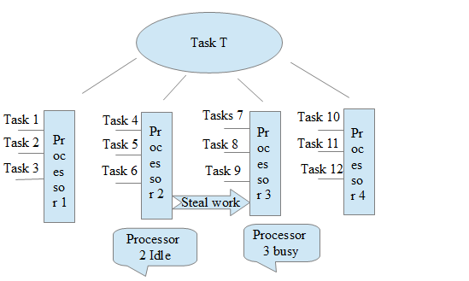

Slide 108
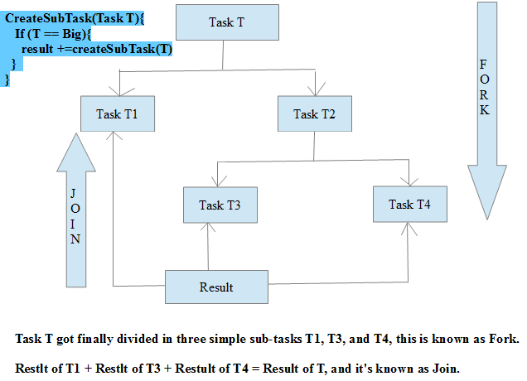

Slide 109
Parallel Array Sorting
Additional utility methods in java.util.Arrays
parallelSort (multiple signatures for different primitives)
Anticipated minimum improvement of 30% over sequential sort
For dual core system with appropriate sized data set
Built on top of the fork-join framework
Uses Doug Lea’s ParallelArray implementation
Requires working space the same size as the array being sorted
Notes:
Check the API documentation for more details of this feature.
See also JEP 103

Slide 110
Atomic Variables
To share an updateable variable among threads, synchronization is used.
Synchronization among multiple threads used to be achieved using the synchronized keyword and it was based on an object’s monitor.
If a thread is not able to acquire an object’s monitor, that thread is suspended and it has to be resumed later.
This way of synchronization (suspending and resuming) uses a great deal of system resources.
The problem is not in the locking and unlocking mechanism of the monitor lock; rather it is in suspending and resuming the threads.
If there is no contention for acquiring a lock, using the keyword synchronized to synchronize threads does not hurt much.

Slide 111
Atomic Variables
An atomic variable uses a lock-free synchronization of a single variable.
If program needs to synchronize on more than one shared variable, you still need to use the old synchronization methods.
By lock-free synchronization, multiple threads can access a shared variable safely using no object monitor lock.
JDK takes advantage of a hardware instruction called “compare-and-swap" (CAS) to implement the lock-free synchronization for one variable.

Slide 112
Atomic Variables
CAS is based on three operands: a memory location M, an expected old value O, and a new value N.
If the memory location M contains a value O, CAS updates it atomically to N; otherwise, it does not do anything.
CAS always returns the current value at the location M that existed before the CAS operation started.

Slide 113
Atomic Variables
CAS(M, O, N) {
currentValueAtM = get the value at Location M;
if (currentValueAtM == O) {
set value at M to N;
}
return currentValueAtM;
}

Slide 114
Atomic Variables
CAS takes an optimistic approach by assuming that there are no other threads updating the value at location M; if the location M contains value O, update it to N;
if the value at location M is not O, do not do anything.
Therefore, if multiple threads attempt to update the value at location M
to different values simultaneously, only one thread will succeed and others will fail.
The synchronization using locks takes a pessimistic approach by assuming that other threads may be working with location M and acquires a lock before it starts working at location M, so that other threads will not access location M while one is working with it.

Slide 115
Atomic Variables
Atomic variable classes are named like AtomicXxx, and can be used to execute multiple instructions on a single variable atomically without using any lock.
Here, Xxx is replaced with different words to indicate different classes that are used for different purposes; for example, the AtomicInteger class is used to represent an int variable, which is supposed to be manipulated atomically.
Twelve classes in the Java class library support read-modify-write operations on a single variable atomically.
They are in the java.util.concurrent.atomic package.

Slide 116
Atomic Variables
They can be classified into
1. Scalar
2. Array Classes
3. Field Updater
4.Compound Variable Classes

Slide 117
Atomic Variables
Scalar Variables
The AtomicInteger, AtomicLong, and AtomicBoolean classes support operations on primitive data types int, long, and boolean, respectively.
If you need to work with other primitive data types, use the AtomicInteger class.
You can use it directly to work with byte and short data types.
Atomic Arrays Classes
There are three classes called AtomicIntegerArray, AtomicLongArray, and AtomicReferenceArray that represent an array of int, long, and reference types whose elements can be updated atomically.

Slide 118
Atomic Variables
Atomic Field Updater Classes
There areThere are three classes called AtomicLongFieldUpdater, tomicIntegerFieldUpdater, and AtomicReferenceFieldUpdater that can be used to update a volatile field of a class atomically using reflection.
These classes have no constructors. To get a reference to an object of these classes, you need to use their factory method called newUpdater().
Atomic Compound Variable Classes
CAS works by asking “Is the value at location M still O?” If the answer is yes, it updates the value at location M from O to N. In a typical scenario, one thread may read the value from location M as O. By the time this thread tries to update the value from O to N, another thread has changed the value at location M from O to P, and back from P to O.

Slide 119
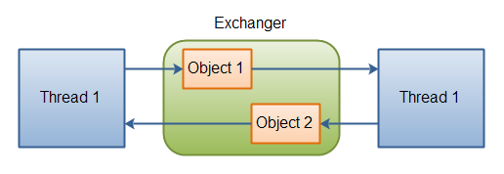
Exchanger

Slide 120
Concurrent hash map
Property | HashMap | Hashtable | ConcurrentHashMap
Null values/keys | allowed | not allowed | not allowed
Is thread-safe | no | yes | yes
Lock mechanism | Not applicable | Locks the whole map | Locks the portion
Iterator | fail-fast | fail-fast | fail-safe

Slide 121
Concurrent hash map
ConcurrentHashMap
You should use ConcurrentHashMap when you need very high concurrency in your project.
It is thread safe without synchronizing the whole map.
Reads can happen very fast while write is done with a lock.
There is no locking at the object level.
The locking is at a much finer granularity at a hashmap bucket level.
ConcurrentHashMap doesn’t throw a ConcurrentModificationException if one thread tries to modify it while another is iterating over it.
ConcurrentHashMap uses multitude of locks.

Slide 122
Synchronized hash map
SynchronizedHashMap
Synchronization at Object level.
Every read/write operation needs to acquire lock.
Locking the entire collection is a performance overhead.
This essentially gives access to only one thread to the entire map & blocks all the other threads.
It may cause contention.
SynchronizedHashMap returns Iterator, which fails-fast on concurrent modification.

Slide 123
Date API
Class | Description
LocalDate | a date, without time of day, offset or zone
LocalTime | the time of day, without date, offset or zone
LocalDateTime | the date and time, without offset or zone
OffsetDate | a date with an offset such as +02:00, without time of day or zone
OffsetTime | the time of day with an offset such as +02:00, without date or zone
OffsetDateTime | the date and time with an offset such as +02:00, without a zone

Slide 124
Date API
ZonedDateTime | the date and time with a time zone and offset
YearMonth | a year and month
MonthDay | month and day
Year/MonthOfDay/DayOfWeek/... | classes for the important fields
DateTimeFields | stores a map of field-value pairs which may be invalid
Calendrical | access to the low-level API
Period | a descriptive amount of time, such as "2 months and 3 days"

Slide 125
Nashorn and Shell Scripting
>jjs
Jjs>print (‘Hello Trainees’);

Slide 126
Java 8: From PermGen to Metaspace
Metaspace: A new memory space is born
The JDK 8 HotSpot JVM is now using native memory for the representation of class metadata and is called Metaspace; similar to the Oracle JRockit and IBM JVM's.
No more java.lang.OutOfMemoryError: PermGen space problems and no need for you to tune and monitor this memory space anymore…not so fast.

Slide 127
Java 8: From PermGen to Metaspace
PermGen space situation
This memory space is completely removed.
The PermSize and MaxPermSize JVM arguments are ignored and a warning is issued if present at start-up.
Metaspace memory allocation model
Most allocations for the class metadata are now allocated out of native memory.
The classes that were used to describe class metadata have been removed.

Slide 128
Java 8: From PermGen to Metaspace
Metaspace capacity
By default class metadata allocation is limited by the amount of available native memory (capacity will of course depend if you use a 32-bit JVM vs. 64-bit along with OS virtual memory availability).
A new flag is available (MaxMetaspaceSize), allowing you to limit the amount of native memory used for class metadata.
If you don’t specify this flag, the Metaspace will dynamically re-size depending of the application demand at runtime.

Slide 129
Java 8: From PermGen to Metaspace
Metaspace garbage collection
Garbage collection of the dead classes and classloaders is triggered once the class metadata usage reaches the “MaxMetaspaceSize”.
Proper monitoring & tuning of the Metaspace will obviously be required in order to limit the frequency or delay of such garbage collections.
Excessive Metaspace garbage collections may be a symptom of classes, classloaders memory leak or inadequate sizing for your application.

Slide 130
Java 8: From PermGen to Metaspace
Java heap space impact
Some miscellaneous data has been moved to the Java heap space. This means you may observe an increase of the Java heap space following a future JDK 8 upgrade.
Metaspace monitoring
Metaspace usage is available from the HotSpot 1.8 verbose GC log output.
Jstat & JVisualVM have not been updated at this point based on our testing with b75 and the old PermGen space references are still present.

Slide 131
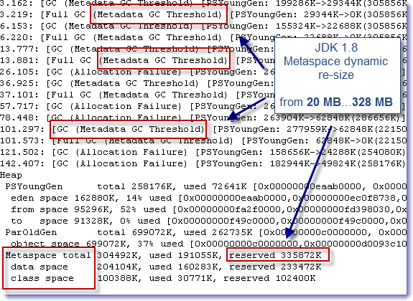

Slide 132
Date And Time APIs
A new date, time, and calendar API for the Java SE platform
Supports standard time concepts
Partial, duration, period, intervals
date, time, instant, and time-zone
Provides a limited set of calendar systems and be extensible to others
Uses relevant standards, including ISO-8601, CLDR, and BCP47
Based on an explicit time-scale with a connection to UTC
Notes:
The new Date and Time API is based on work by Stephen Colebourne and others who created the Joda-Time library.
It includes classes like:
Clock – access to the current date and time
ZoneId – To represent timezones
LocalTime – A time without a time zone
LocalDateTime – A date and time which is immutable.
Internal storage using just the offset in nanosecods from the Epoch.
Things like day and date, etc are calculated on demand to improve efficiency.
Partial time, e.g. March 20th (no year).
Duration (nanos),
period (minutes, days, etc),
Interval nanos between two points in time.
See also JEP 150 and JSR 310

Slide 133
Base64 Encoding and Decoding
Currently developers are forced to use non-public APIs
sun.misc.BASE64Encoder
sun.misc.BASE64Decoder
Java SE 8 now has a standard way
java.util.Base64.Encoder
java.util.Base64.Decoder
encode, encodeToString, decode, wrap methods
Notes:
Finally Java has a public API for performing base64 encoding and decoding, rather than using a private API.
See also JEP 135

Slide 134
Nashorn JavaScript Engine
Lightweight, high-performance JavaScript engine
Integrated into JRE
Use existing javax.script API
ECMAScript-262 Edition 5.1 language specification compliance
New command-line tool, jjs to run JavaScript
Internationalised error messages and documentation
Notes:
Nashorn is a complete rewrite of the JavaScript engine included in the JDK and replaces the old Rhino version.
JavaScript applications can be run on their own using the new jjs command, or integrated into Java code using the existing javax.script API.
See also JEP 174

Slide 135
Removal Of The Permanent Generation
Permanently
No more need to tune the size of it
Current objects moved to Java heap or native memory
Interned strings
Class metadata
Class static variables
Part of the HotSpot, JRockit convergence
Notes:
Tuning of the permanent generation that holds data used by the VM like Class and Method objects as well as interned strings, etc has been problematic in the past. The removal of the permanent generation will simplify tuning.
See also JEP 122

Slide 136
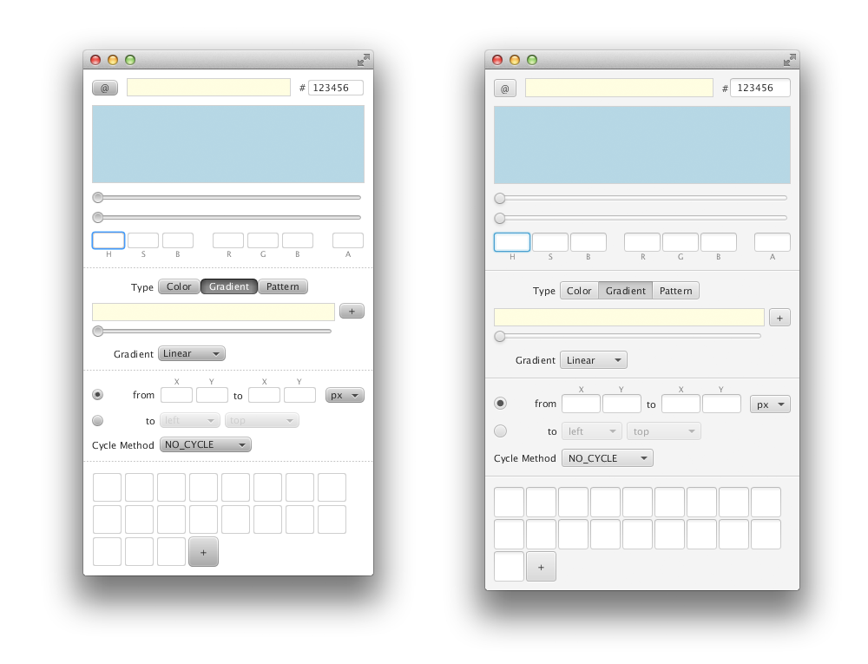
JavaFX 8
Caspian
Modena
New Theme
vs
Notes:
JavaFX 8 includes a new stylesheet, named Modena. This provides a more modern look to JavaFX 8. The older, Caspian, stylesheet can still be used.

Slide 137
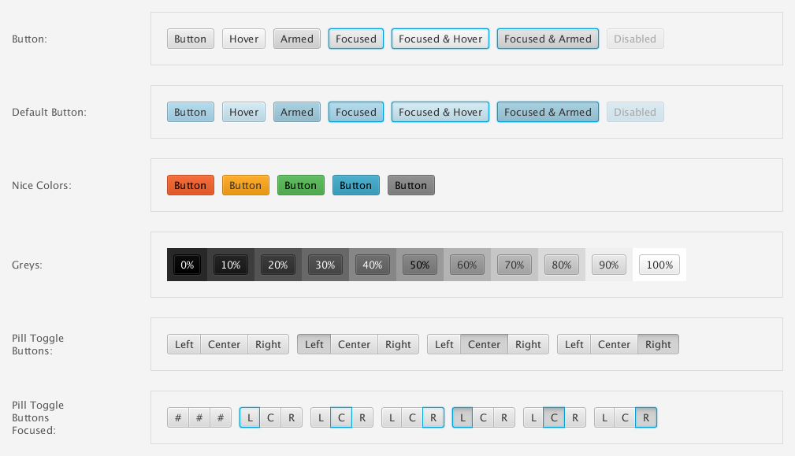
Modena
Copyright © 2012, Oracle and/or its affiliates. All rights reserved.

Slide 138
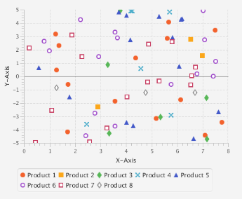
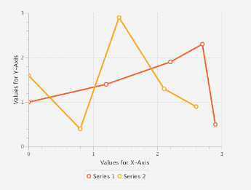
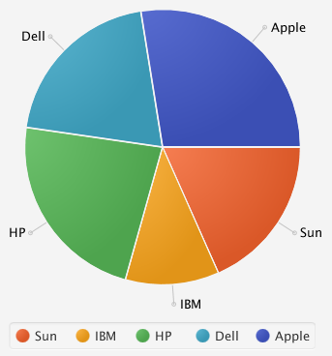
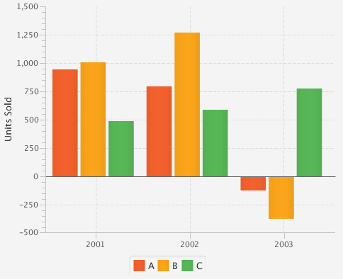
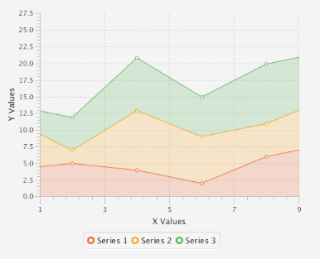
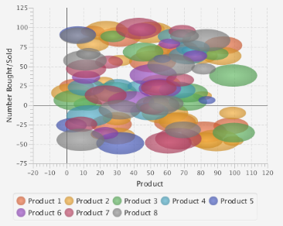
Modena
Copyright © 2012, Oracle and/or its affiliates. All rights reserved.

Slide 139
JavaFX 8
Improvements To Full Screen Mode
Customisable
Configurable key combinations to exit full screen mode
Ability to prevent user exiting full screen mode
// Set the key combination that the user can use to exit
stage.setFullScreenExitKeyCombination(KeyCombination.NO_MATCH);
// Setup the click handler so we can escape from full screen
Rectangle r = new Rectangle(0, 0, 250, 250);
r.setOnMouseClicked(e -> stage.setFullScreen(false));
// Set full screen again
stage.setFullScreen(true);
Notes:
Java FX 8 includes improvements to support for full screen mode. For applications like kiosks and terminals it is now possible to configure special key sequences to exit full screen mode, or even to disable the ability to exit full screen mode altogether,

Slide 140
JavaFX 8
Printing Support
New API for printing
Currently only supported on desktop
Any node can be printed
PrinterJob job = PrinterJob.createPrinterJob(printer);
job.getJobSettings().setPageLayout(pageLayout);
job.getJobSettings().setPrintQuality(PrintQuality.HIGH);
job.getJobSettings().setPaperSource(PaperSource.MANUAL);
job.getJobSettings().setCollation(Collation.COLLATED);
if (job.printPage(someRichText))
job.endJob();
Notes:
JavaFX 8 includes a printing API, so any node from the scenegraph can be printed. This feature is currently only supported on the desktop version of JavaFX, it is not currently supported in the embedded version.

Slide 141
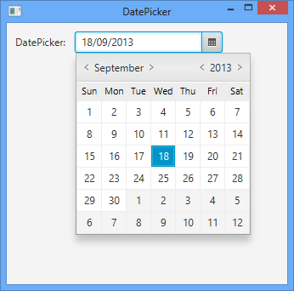
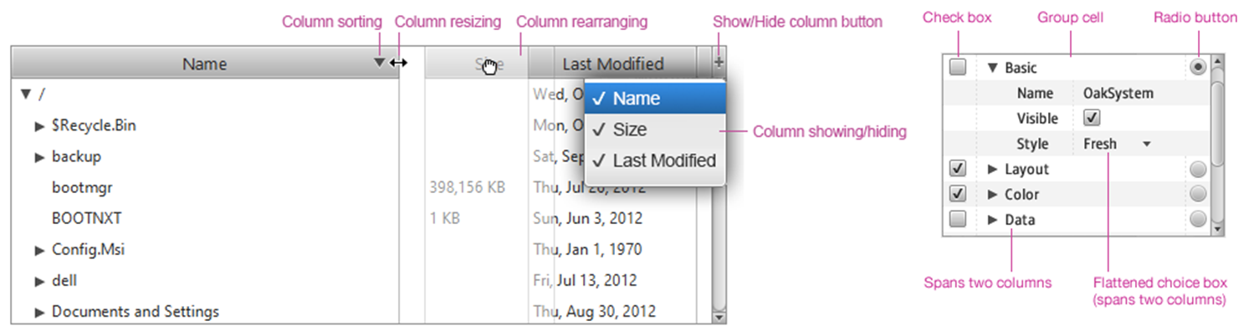
JavaFX 8
New Controls
DatePicker
TreeTableView
Notes:
JavaFX 8 includes a few new controls. Most notable of these is the date picker, which has been something people have been asking for. A combination table and tree view has also been included.

Slide 142
DatePicker
The JavaFX DatePicker is designed with the new
Calendaring APIs in Java 8 using java.time
Copyright © 2012, Oracle and/or its affiliates. All rights reserved.

Slide 143
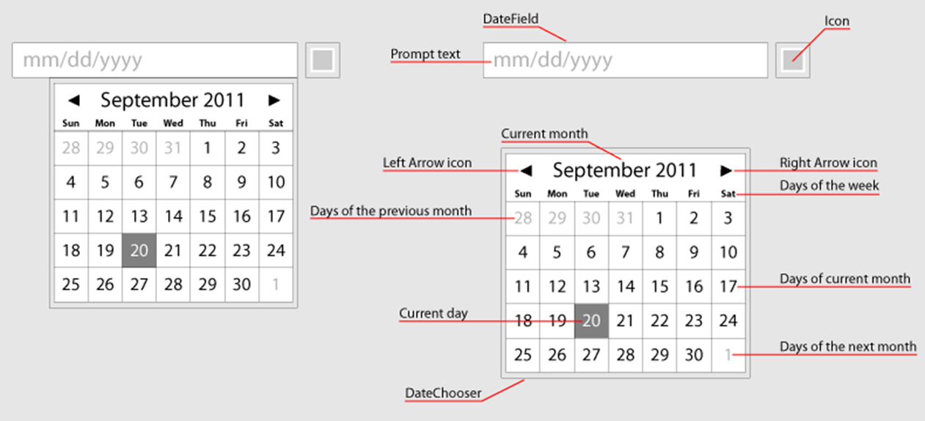
DatePicker
143

Slide 144
DatePicker
import java.time.LocalDate; // From new Date/Time API
...
LocalDate ld;
DatePicker dp = new DatePicker();
dp.setOnAction(e -> {
ld = dp.getValue();
System.out.println("Date selected " + ld);
});
Copyright © 2012, Oracle and/or its affiliates. All rights reserved.

Slide 145
Date Picker
Copyright © 2012, Oracle and/or its affiliates. All rights reserved.

Slide 146
TreeTableView
UI control with combined TreeView and TableView controls functionality
146

Slide 147

JavaFX 8
Touch Support
Gestures
Swipe
Scroll
Rotate
Zoom
Touch events and touch points
Notes:
As more devices are supporting the concept of touch interfaces JavaFX supports these types of interface using specific APIs. Gestures like swipe, scroll, zoom and rotate are supported as event listeners and touch specific events can be detected as well as multiple touch points.

Slide 148
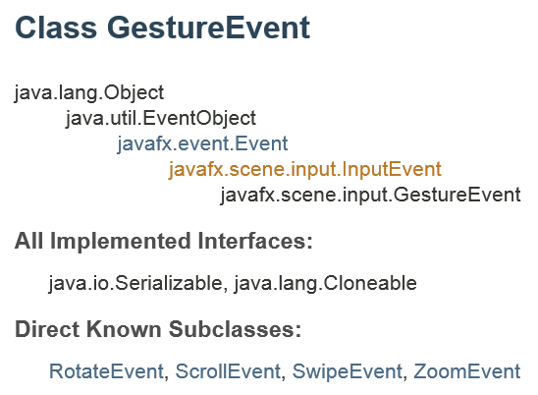

Touch Gestures

Slide 149

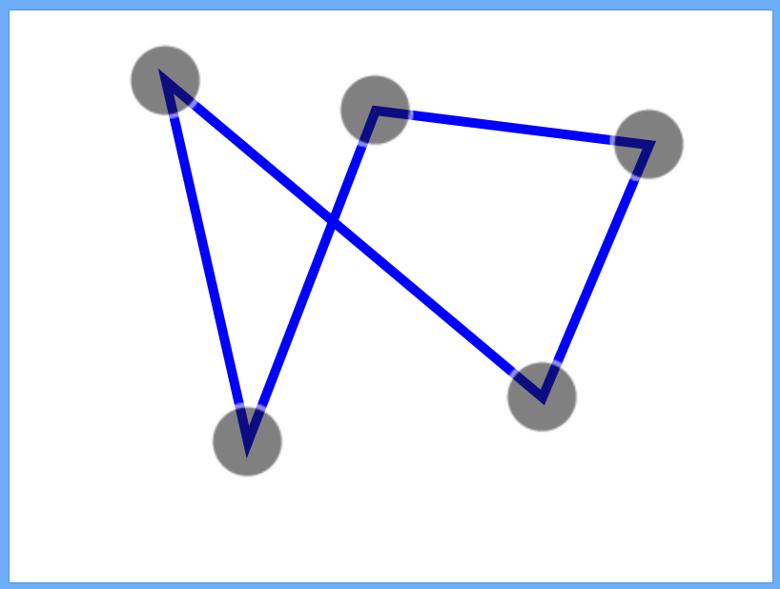
Handling Touch (TouchEvent/TouchPoint)
A TouchEvent contains information about a touch, including:
Event type: Pressed, released, moved, or stationary
Touch points: The TouchPoint instances that represent each of the points that were touched
Each TouchEvent has a unique ID to identify the events and touch points in a multi-touch action

Slide 150
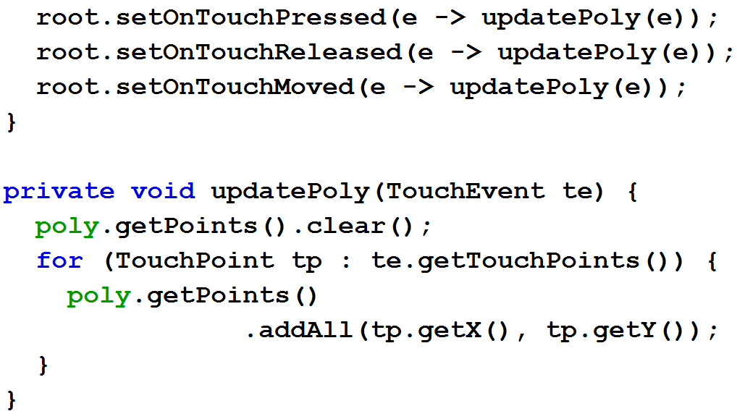
Responding to Touch Events

Slide 151
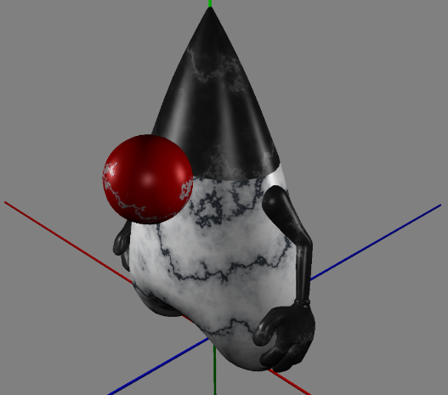
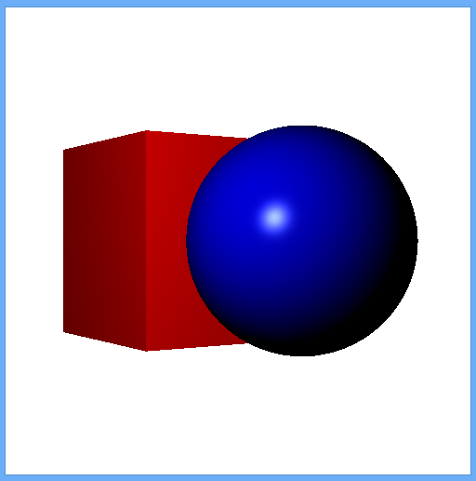

JavaFX 8
3D Support
Predefined shapes
Box
Cylinder
Sphere
User-defined shapes
TriangleMesh, MeshView
PhongMaterial
Lighting
Cameras
Notes:
JavaFX 8 adds comprehensive support for 3D interfaces. All the features you would expect ot find are available. Basic shapes that can be combined to form more complex shapes as well as the ability to construct shapes of arbritary complexity using meshes and trangle meshes.
PhongMaterials are used to define how the surface of a 3D shape is rendered and these can include texture mappings.
Both lighting sources and camera types and positions can be specified,

Slide 152

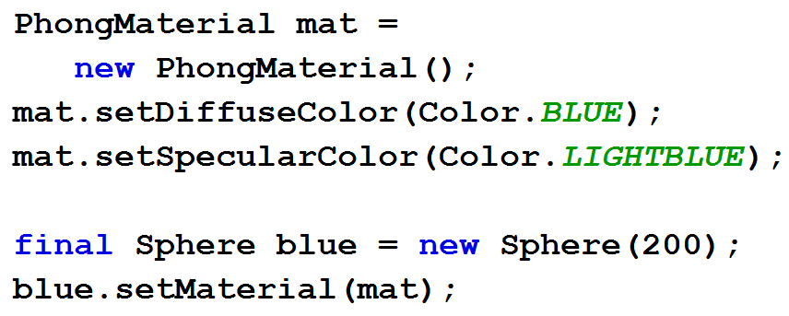

Creating Primitive Shapes and Materials
152

Slide 153

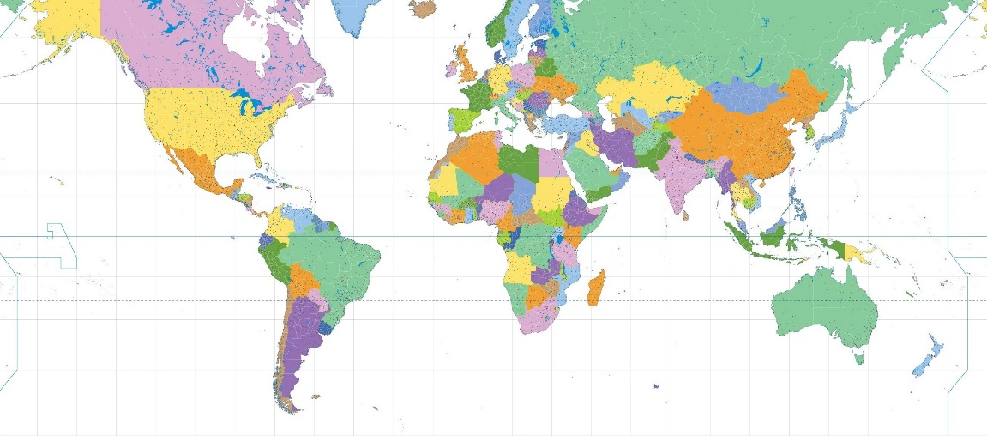
Placing a Texture on a Sphere
153

Slide 154
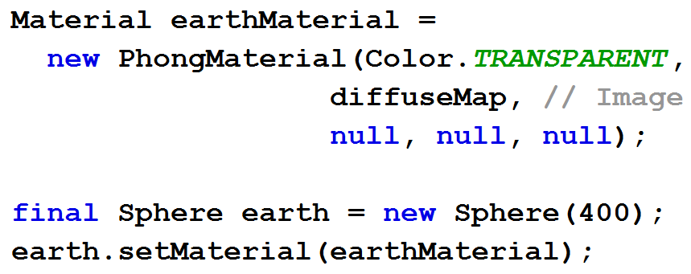
Placing a Texture on a Sphere
154

Slide 155

3D Lights
Lights are nodes in the scene graph
PointLight
AmbientLight
Default light provided if no active lights
155

Slide 156
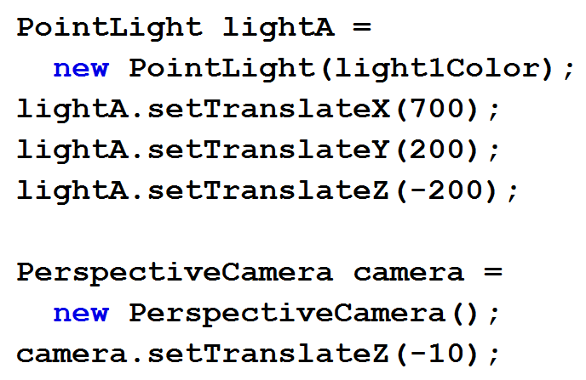

Lights, Camera, Action!
156

Slide 157
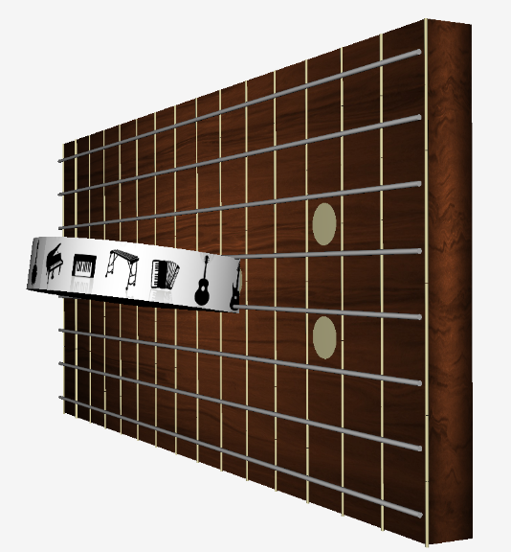
Example 3D multi-touch app: ZenGuitar3D

Slide 158
Compact Profiles
Approximate static footprint goals
Compact1 Profile
11Mb
Compact2 Profile
16Mb
Compact3 Profile
30Mb
Full JRE
54Mb
Notes:
Modularisation of the Java platform. Since project Jigsaw was pushed back to Java SE 9 some form of modularisation was needed to make the Java platform more flexible. To do this we now have three compact profiles that subset the standard class libraries to allow applications that only need certain APIs to run in a smaller resource footprint.
Compact 1 is the smallest subset of packages that supports the Java language. Includes logging and SSL. This is the migration path for people currently using the compact device configuration (CDC)
Compact 2 adds support for XML, JDBC and RMI (specifically JSR 280, JSR 169 and JSR 66)
Compact 3 adds management, naming, more security and compiler support.
None of the compact profiles include any UI APIs, they are all headless.
See also JEP 161

Slide 159
Java SE Embedded
Optimised binary for embedded use from devices to gateways
Latest Java innovations in the smallest footprint
Use of compact profiles
Approximate JRE size 20.4Mb (ARM v7 VFS, Hard Float)
Compact profile 1: 10.4Mb
JavaFX: 10Mb
Production ready binary for popular platforms that run Linux
ARM v6/7 with Hard floating point
Raspberry Pi is one of the reference platforms
Notes:
Java SE Embedded is a binary distribution of Java SE that runs on the ARM processor architecture version 6 and 7 and supports hardware floating point acceleration
One of the reference platforms is the Raspberry Pi providing a very low cost way to develop and test Java SE Embedded applications.

Slide 160

Java ME 8: Building The Internet of Things
Notes:
Now let’s move onto the new features in Java ME 8, and how these can be used to build embedded devices for the internet of things.

Slide 161












Java ME 8 Focus
Footprint
100MB+
ARM Cortex M3/M4
ARM Cortex-A
10MB-100MB
1MB-10MB
50KB-1MB
Java SE Embedded
Java Embedded Suite
Oracle Event Processing Embedded
Java Card
Java ME Embedded
Java SE
SECURITY SMALL EMBEDDED MEDIUM EMBEDDED LARGE EMBEDDED DESKTOP SERVER
Notes:
Java ME covers a broad range of devices and platforms, from microcontroller systems such as ARM Cortex-M3/M4 up to more powerful, mid-range embedded systems with many MB of memory and powerful processors such as ARM Cortex-A.

Slide 162
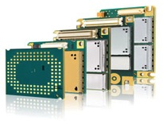



Java ME 8 Platform Overview
Use Case Software
(e.g. smart pen)
Use Case Software
(e.g. wireless module)
Use Case Software
(e.g. control unit)
Use Case Software
(e.g. smart meter)
Additional APIs
(Examples)
Messaging
Wireless
Communication
Protocols and
Data Conversion
Security and
Management
Additional Optional APIs
Location
Web Services
Sensors
Additional Optional JSRs
Vertical Specific
APIs
On-Device I/O Access
Generic Connection Framework
Application Platform
Security and Trust Services
On-Device I/O Access
Device I/O API
GCF 8
Java ME Embedded Profile
(MEEP) 8 (JSR 361)
SATSA (JSR 177)
Java VM
Java ME Connected Limited Device Configuration (CLDC) 8 (JSR 360)
Notes:
Java ME 8 is designed as a flexible software platform to address many of the challenges in the embedded software space and Internet of Things. Let me give you a brief overview.
In this stack diagram, the bottom later is the Java ME Connected Limited Device Configuration 8 (CLDC 8, JSR 360) which provides the core Java Virtual Machine (VM) and Java runtime.
On top of CLDC 8 there is the Java ME Embedded Profile 8 (MEEP 8, JSR 361) which defines an advanced application platform. MEEP 8 is supported by the Device I/O API, which we will talk about later and the Generic Connection Framework 8 (GCF 8) – which is defined in the context of CLDC 8 - and which provides a flexible framework for connectivity with local and networked resources. Finally, the Security and Trust Services API (SATSA, JSR 177) provides additional APIs for security functionality.
On top of these two core layers there can be any number of use-case specific APIs and applications in order to tailor the system for a particular solution. The diagram shows a couple of examples, such as a smart pen device, wireless modules, a unit for an industrial control application, or a smart meter.
So, to summarize, Java ME 8 provides a layered and extensible platform architecture which allows you to build customized software solutions quickly to cover a wide range of embedded use cases.

Slide 163
Java ME 8 Key Features
Aligned with Java SE 8
Language, libraries, VM
Designed for embedded
Fully headless operation
Remote software provisioning and management
Highly portable and scalable
Minimum RAM footprint of 1Mb
Consistent across devices
Notes:
Key features for Java ME 8:
Alignment with Java SE 8 language, libraries and VM. There are some restrictions to this: invokedynamic is not supported in the VM and Lambda expressions and the streams API is not yet supported.
Designed for fully headless operation, i.e. no user interface. Remote provisioning and management of software means that new versions or new services can easily be uploded to devices deployed in the field without physical access.
Java ME 8 has been designed to be very portable to simplify supporting new platforms. With a minimum RAM footprint of 1Mb Java ME 8 has extremely wide applicability.
Through the use of a virtual machine application code becomes consistent across all devices (“write once, run anywhere”).

Slide 164
Java ME 8 Key Features
Advanced application platform
Multi-application model
Modularised software services
Faster and more flexible software development and deployment
Multi-client domains (“partitioning”)
Different clients can have different security domains
Access to peripheral devices (Device I/O API)
Compatible with JCP/JSR standard APIs
Notes:
Java ME 8 supports the concept of multiple applications running concurrently on the same platform and includes the ability to share persistent data between Midlets in the same suite. There is also an API for inter-MIDlet communication at runtime.
By designing Java ME 8 to be modular through optional APIs flexible development and deployment is easily achieved.
To enhance security different domains can be used by different MIDlets providing different services so that only the permissions that are required by that MIDlet can be used.
The device IO API is a big new addition to Java ME 8 which provides a standard way of using industry standard interfaces for connecting to low level external devices. The device IO API supports features like GPIO, I2C, SPI and serial communication via UARTs.
Using the Java Community Process and Java Specification Requests means we have a clear set of standards for all APIs

Slide 165

Connected Limited Device Configuration 8
CLDC 8 Key Features
Developer leverage of tools, APIs and knowledge
GCF 8 to provides flexible networking
Compact Configuration for very small devices
Library Alignment with SE 8
VM Alignment with SE 8
Language Alignment with SE 8
Notes:
Java ME 8 consists of both a configuration and profiles. The connected limited device configuration (CLDC) has been updated bringing the language, libraries and VM into alignment with Java SE 8 (with the exceptions mentioned earlier). The configuration has also been tuned to minimise its resource footprint. The generic connection framework has been greatly expanded (we’ll cover that in detail on the next slide). One of the key advantages of CLDC 8 is the ability of developers to leverage existing knowledge of tools and APIs.

Slide 166
Generic Connection Framework 8
Substantially Increased Range of Connection Types
SecureServerConnection
SecureDatagramConnection
ModemConnection
UDPMulticastConnection
CommConnection
HttpConnection
HttpsConnection
SecureConnection
ServerSocketConnection
SocketConnection
UDPDatagramConnection
Notes:
The Generic Connection Framework has a much wider range of types of connection that can be used. Refer to the API documentation for details of each of these.

Slide 167
Java ME Embedded Profile (MEEP) 8
Architecture
Application or Service
Application or Service
Application or Service
MEEP 8
javax.
microedition.
rms
(optional)
javax.
microedition.
media
(optional)
javax.
microedition.
key
(optional)
javax.
microedition.
lui
(optional)
javax.
microedition.
cellular
(optional)
NEW
UPDATED
javax.
microedition.
midlet
javax.
microedition.
swm
(optional)
javax.
microedition.
event
(optional)
javax.
microedition.
power
(optional)
javax.
microedition.
io
(optional)
CLDC 8
Notes:
Building on the CLDC 8 is the Java ME Embedded Profile (MEEP) 8. As you can see from the diagram there are a number of new and updated API packages (this shows the flexible nature of Java ME that can be configured based on the requirements of the platform and application. Refer to the API documentation for more information on each package.

Slide 168
NetBeans 8: The IDE For Java 8
Notes:
Now let’s look at how NetBeans 8 gives us a way to use all these great new features when we develop code.

Slide 169
Annotations
Java 5 Annotations
public class Manager extends Employee {
@Override
public void setSalary(int salary) {
System.out.println("Manager.setSalary():" + salary);
}
}

Slide 170
Declaring an Annotation Type
<modifiers> @ interface <annotation-type-name> {
// Annotation type body goes here
}

Slide 171
Restriction #1
An annotation type cannot inherit from another annotation type
// Won't compile
public @interface WrongVersion extends BasicVersion {
int extended();
}

Slide 172
Every annotation type implicitly inherits the java.lang.annotation.Annotation interface
package java.lang.annotation;
public interface Annotation {
boolean equals(Object obj);
int hashCode();
String toString();
Class<? extends Annotation> annotationType();
}

Slide 173
Restriction #2
Method declarations in an annotation type cannot specify any parameters.
A method declares an element for the annotation type.
An element in an annotation type lets you associate a data value to an annotation’s instance.
A method declaration in an annotation is not called to perform any kind of processing.

Slide 174
Restriction #2
An element as an instance variable in a class having two methods, a setter and a getter, for that instance variable.
For an annotation, the Java runtime creates a proxy class that implements the annotation type (which is an interface).
Each annotation instance is an object of that proxy class.
The method you declare in your annotation type becomes the getter method for the value of that element you specify in the annotation.
The Java runtime will take care of setting the specified value for the annotation elements. Since the goal of declaring a method in an annotation type is to work with a data element, you do not need to (and are not allowed to) specify any parameters in a method declaration.

Slide 175
Restriction #2
// Won't compile
public @interface WrongVersion {
// Cannot have parameters
String concatenate(int major, int minor);
}

Slide 176
Restriction #3
Method declarations in an annotation type cannot have a throws clause.
A method in an annotation type is defined to represent a data element.
Throwing an exception to represent a data value does not make sense.
// Won't compile
public @interface WrongVersion {
int major() throws Exception; // Cannot have a throws clause
int minor(); // OK
}

Slide 177
Restriction #4
The return type of a method declared in an annotation type must be one of the following types:
• Any primitive type: byte, short, int, long, float, double, boolean, and char
• java.lang.String
• java.lang.Class
• An enum type
• An annotation type
• An array of any of the above mentioned type, for example, String[], int[], etc. The return
type cannot be a nested array. For example, you cannot have a return type of String[][] or
int[][].

Slide 178
Restriction #4
public @interface GoodOne {
Class element1(); // Any Class type
Class<Test> element2(); // Only Test class type
Class<? extends Test> element3(); // Test or its subclass type
}
The return type of Class needs a little explanation. Instead of the Class type, you can use a generic return type that will return a user-defined class type.
Suppose you have a Test class and you want to declare the return type of a method in an annotation type of type Test.

Slide 179
Restriction #5
An annotation type cannot declare a method, which would be equivalent to overriding a method in the Object class or the Annotation interface.

Slide 180
Restriction #6
An annotation type cannot be generic.

Slide 181
Default Value of an Annotation Element
<modifiers> @interface <annotation type name> {
<data-type> <element-name>() default <default-value>;
}
public @interface Version {
int major();
int minor() default 0; // Set zero as default value for minor
}

Slide 182
Default Value of an Annotation Element
@Version(major=1) // minor is zero, which is its default value
@Version(major=2) // minor is zero, which is its default value
@Version(major=2, minor=1) // minor is 1, which is the specified value
// Shows how to assign default values to elements of different types
public @interface DefaultTest {
double d() default 12.89;
int num() default 12;
int[] x() default {1, 2};
String s() default "Hello";
String[] s2() default {"abc", "xyz"};
Class c() default Exception.class;
Class[] c2() default {Exception.class, java.io.IOException.class};
}

Slide 183
Annotation Type and Its Instances
Version v = null; // Here, Version is an annotation type
A Class Implementing an Annotation Type
// DoNotUseIt.java
package com.jdojo.annotation;
import java.lang.annotation.Annotation;
public class DoNotUseIt implements Version {
// Implemented method from the Version annotation type
@Override
public int major() {
return 0;
}

Slide 184
Annotation Type and Its Instances
// Implemented method from the Version annotation type
@Override
public int minor() {
return 0;
}
// Implemented method from the Annotation annotation type,
// which is the supertype of the Version annotation type
@Override
public Class<? extends Annotation> annotationType() {
return null;
}

Slide 185
Using Annotations
public @interface PrimitiveAnnTest {
byte a();
short b();
int c();
long d();
float e();
double f();
boolean g();
char h();
}
@PrimitiveAnnTest(a=1, b=2, c=3, d=4, e=12.34F, f=1.89, g=true, h='Y')

Slide 186
String Types
public @interface Name {
String first();
String last();
}
@Name(first="John", last="Jacobs")
public class NameTest {
@Name(first="Wally", last="Inman")
public void aMethod() {
// More code goes here...
}
}

Slide 187
Class Types
public class DefaultException extends java.lang.Throwable {
public DefaultException() {
}
public DefaultException(String msg) {
super(msg);
}
}

Slide 188
Class Types
@Retention(RetentionPolicy.RUNTIME)
@Target(ElementType.METHOD)
public @interface TestCase {
Class<? extends Throwable> willThrow() default DefaultException.class;
}

Slide 189
Enum Type
public @interface Review {
ReviewStatus status() default ReviewStatus.PENDING;
String comments() default "";
// ReviewStatus enum is a member of the Review annotation type
public enum ReviewStatus {PENDING, FAILED, PASSED, PASSEDWITHCHANGES};
}

Slide 190
Enum Type
@Review()
// Leave status as Pending, but add some comments
@Review(comments="Have scheduled code review on June 3 2014")
// Fail the review with comments
@Review(status=ReviewStatus.FAILED, comments="Need to handle errors")

Slide 191
Annotation Type
public @interface Description {
Name name();
Version version();
String comments() default "";
}

Slide 192
Annotation Type
@Description(name=@Name(first="John", last="Jacobs"),
version=@Version(major=1, minor=2),
comments="Just a test class")
public class Test {
// Code goes here
}

Slide 193
Array Type Annotation Element
public @interface ToDo {
String[] items();
}
@ToDo(items={"Add readFile method", "Add error handling"})
public class Test {
// Code goes here
}

Slide 194
No Null Value in an Annotation
Using the following annotations will
result in compile-time errors:
@ToDo(items=null)
@Name(first=null, last="Jacobs")

Slide 195
Shorthand Annotation Syntax
public @interface Enabled {
boolean status() default true;
}
@Enabled
public class Test {
// Code goes here
}
@Enabled()
public class Test {
// Code goes here
}

Slide 196
Marker Annotation Types
public @interface Marker {
// No element declarations
}
A marker annotation type is an annotation type that does not declare any elements, not even one with a default value.
Typically, a marker annotation is used by the annotation processing tools, which generate boilerplate code based on the marker annotation type.

Slide 197
Marker Annotation Types
@Marker
public class Test {
// Code goes here
}

Slide 198
Meta-Annotation Types
Meta-annotations types are annotation types, which are used to annotate other annotation types.
The following annotation types are meta-annotation types:
• Target
• Retention
• Inherited
• Documented
• Repeatable
• Native
Meta-annotation types are part of the Java class library. They are declared in the package java.lang.annotation.

Slide 199
The Target Annotation Type

Slide 200
The Retention Annotation
An annotation can be retained at three levels.
• Source code only
• Class file only (the default)
• Class file and the runtime

Slide 201
The Retention Annotation
The Retention meta-annotation type is used to specify how an annotation instance of an annotation type should be retained by Java.
This is also known as the retention policy of an annotation type. If an annotation type has a “source code only” retention policy, instances of its type are removed when compiled into a class file.
If the retention policy is “class file only,” annotation instances are retained in the class file, but they cannot be read at runtime.
If the retention policy is “class file and runtime” (simply known as runtime), the annotation instances are retained in the class file and they are available for reading at runtime

Slide 202
The Inherited Annotation Type
The Inherited annotation type is a marker meta-annotation type.
If an annotation type is annotated with an Inherited meta-annotation, its instances are inherited by a subclass declaration.
It has no effect if an annotation type is used to annotate any program elements other than a class declaration.

Slide 203
The Inherited Annotation Type
public @interface Ann2 {
int id();
}
@Inherited
public @interface Ann3 {
int id();
}
Let’s declare two classes, A and B, as follows. Note that class B inherits class A.
@Ann2(id=505)
@Ann3(id=707)
public class A {
// Code for class A goes here
}

Slide 204
The Inherited Annotation Type
// Class B inherits Ann3(id=707) annotation from the class A
public class B extends A {
// Code for class B goes here
}

Slide 205
The Documented Annotation
The Documented annotation type is a marker meta-annotation type.
If an annotation type is annotated with a Documented annotation, the Javadoc tool will generate documentation for all of its instances.

Slide 206
The Repeatable Annotation
Prior to Java 8, it was not allowed to repeat an annotation in the same context. For example, the following repeated use
of the Version annotation would generate a compile-time error:
@Version(major=1, minor=1)
@Version(major=1, minor=2)
public class Test {
// Code goes here
}

Slide 207
Commonly Used Standard Annotations
Java API defines many standard annotation types.
They are defined in the java.lang package.
They are
• Deprecated
• Override
• SuppressWarnings
• FunctionalInterface

Slide 208
The FunctionalInterface Annotation Type
An interface with one abstract method declaration is known as a functional interface.
Previously, a functional interface was known as SAM (Single Abstract Method) type.
The compiler verifies all interfaces annotated with a @FunctionalInterface that the interfaces really contain one and only one abstract method.
A compile-time error is generated if the interfaces annotated with this annotation are not functional interfaces.
It is also a compile-time error to use this annotation on classes, annotation types, and enums.
The FunctionalInterface annotation type is a marker interface.

Slide 209
The FunctionalInterface
The following declaration of the Test class uses a @FunctionalInterface annotation, which will generate a compile-time error because a @FunctionalInterface annotation can only be used on interfaces.
@FunctionalInterface
public class Test {
public void test() {
// Code goes here
}
}

Slide 210
Annotating a Java Package
A package declaration appears as part of a top-level type declaration.
Further, the same package declaration occurs multiple times at different places.
Create a file, which should be named package-info.java, and place the annotated package declaration in it.
// package-info.java
@Version(major=1, minor=0)
package com.jdojo.annotation;

Slide 211
Annotating a Java Package
// package-info.java
@com.jdojo.myannotations.Author("John Jacobs")
@Reviewer("Wally Inman")
package com.jdojo.annotation;
import com.jdojo.myannotations.Reviewer;

